Slide 1
A simple gradebook database
David Kirch

Slide 2
Proposal
I set out to create a simple database for keeping track of students grades.
It would keep track of things like the professor, the grade, the student, and other associated information.
I chose not to focus on the front end part of the database.

Slide 3
Business Rules
A professor can teach many classes
A class has only one professor
A professor can give many assignments
An assignment is given by only one professor
A class may have many students enrolled
A student can be enrolled in many classes
A grade is given for one assignment

Slide 4
Business Rules
A student will have many grades
A grade is given to only one student
There can be different types of assignments like classwork, homework, exams, etc…

Slide 5
Tables
Professor
Student
Grade
Assignment
Class
Enrolled (Resolved a M:N relationship between student and class)

Slide 6
Attributes
Professor - Professor ID number, professor first name, professor last name, professor office number, professor phone number, professor department.
Class - Class ID number, number of students, maximum size, class name, current term, start date, end date, department, professor ID.
Student - Student ID number, student first name, student last name, student email, student class level, student address.
Assignment - Assignment number, assignment type (test, quiz, homework), assignment description, maximum points, due date, assigned date, professor ID.
Grade - Grade percent, student ID, assignment number.
Enrolled - Enrollment ID, class ID, student ID.

Slide 7
Design Table
Most things were made varchar
Grade percent was a float (5,2)
Max points, number of students, and assignment number were integers
Chose what seemed appropriate, but I didn‘t want to restrict how things might be entered into the system

Slide 8
ERM

Slide 9
SQL Code
Creating a table -
create table Professor(
Professor_ID varchar (10) not null,
Professor_Fname varchar(255),
Professor_Lname varchar(255),
Professor_Office varchar(255),
Professor_PhoneNumber varchar(10),
Professor_Department varchar(255),
Primary Key (Professor_ID)
);

Slide 10
SQL Code
Adding foreign keys -
Alter Table Class
Add Foreign Key (Professor_Professor_ID)
References Professor (Professor_ID) On update cascade on delete cascade;

Slide 11
SQL Code
Insert -
insert into professor values ('smithj1', 'John', 'Smith', 'Sci 1356', '3031234567', 'CS');

Slide 12
SQL Code
Delete -
delete from student where student_id = 'carson92';

Slide 13
Problems
Adding foreign key constraints before I created the cooresponding table
Changes not applying to all tables
Having incorrect foreign key attributes in related tables

Slide 14
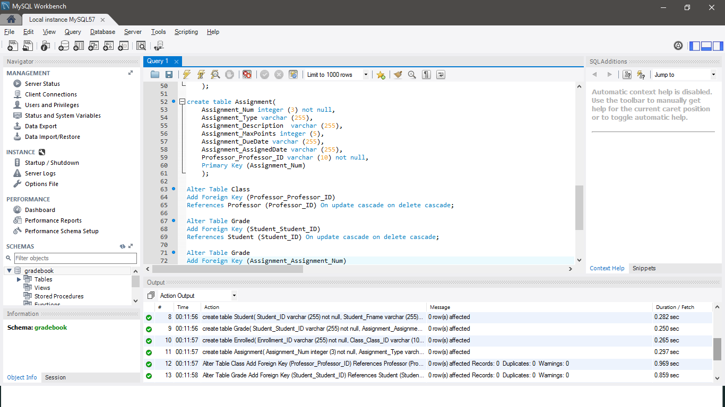
Results

Slide 15
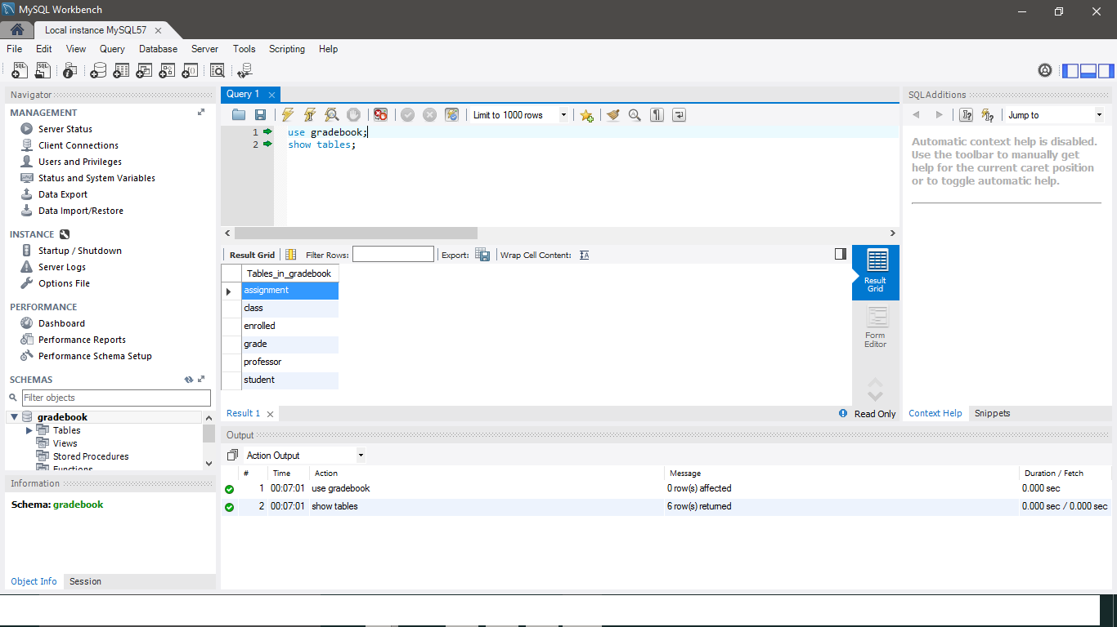
Results

Slide 16
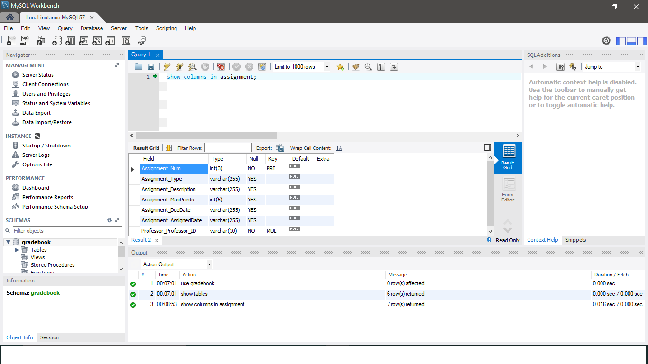
Results

Slide 17
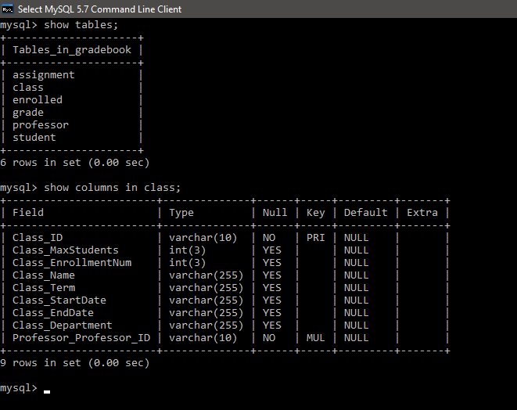
Results

Slide 18
Any Questions?

